Slide 2
F# 6 Fundamentals
Michael Heydt
Developer and Trainer
@mikeheydt www.smac.io

Slide 3




Topics in the course

Slide 4
You’ll have a good understanding of the F# language

Slide 5
PREREQUISITES Basic knowledge of imperative programming concepts and of the .NET platform

Slide 6
F# 6 Fundamentals
Getting Started with F# 6 and .NET 6
Michael Heydt
Developer and Trainer
@mikeheydt www.smac.io
Notes:
Hello, and welcome to F# 6 Fundamentals.
My name is Micahel Heydt, and I’m very exicted to bring to you this course and to have you join me in learning f#.
We’re going to have a lot of fun learning about this awesome programming language.

Slide 7

Learning F# is Awesome!
It will make you a better programmer
Notes:
F# is one of the programming languages on the .NET platform, and while it’s not as popular as say, c#, it’s awesome for building applications and services. It has a rich history, is actively maintained and evolving, and has full support of the .net platform capabilities. And any type of application you can build with .NET, you can also build with F#.
It’s different from C# in it is a functional functional first programming language, focusing on declaratively expressing what to do and now how to every little detail. Code written in F# is often much more concise than equivalent object oriented code, and often more correct and error free.
Simply said, learning F# will make you a better programmer, even in OO languages such as C#.

Slide 8

Hello .NET
Developer Platform
Open Source
Cross-Platform
Notes:
What’s .NET then?
.NET is a developer platform created by Microsoft for us to use to develop applications and services.
It’s gives the developer a rich set of tools to build just about any type of application.
NET is open source too, so you can go an see all of the code that it is built with.
It is also clross platform. This has been true for several variants of .net from .net core onwards, but .NET 6 brings true cross platform allowing your apps to run on windows, linux, mac and many mobile platforms.

Slide 9
What Can You Do with .NET?
.NET 6
Notes:
So what can you build with .NET? Well, the simple answer is almost anything.
You can start with simple apps and learn some basics, which is what we will do in this course with F#.
But you can build all kinds of applicaitons
But .NET has got you covered, and can grow with you to build all sorts of applications including desktop applications with a graphical interface, cloud apps, web applications, games, mobile applications, and even AI, or applications powered with artificial intelligence. .NET is quite frankly huge.
When we are building applications with .NET, we are tapping into the entire ecosystem that will help you with all your endeavors. .NET contains several languages that we can use to write our code. There's a very extensive set of libraries that you can use, which offers a lot of functionalities that's already been created for you, both from Microsoft and from the community. And finally, .NET comes with several tools that you can use to create your applications. Tools are available for all environments including Windows, Mac, and Linux, thus giving everyone the ability to write .NET applications. In this course, we are using .NET 6. One of the cool things about .NET 6 is that it can run everywhere. .NET 6 is what we call cross‑platform. It is not tied to just Windows, for example. So just like the tools we use to create them, the applications we create with .NET can run on Windows, Linux, and Mac. As I just mentioned, there are different languages available to write your .NET applications, one of them being C#. In this course, we will be using C# 10. Other languages include Visual Basic and F#. To follow along with this course on C#, no previous knowledge about the language is required. This course will teach you everything you need to know right from the very beginning, so this course is aimed at learning how to write .NET applications with C#. If you're coming from another language like Java or C++, this course will be a great fit too, to help you gain the required knowledge to write C# applications. I will assume only some very basic understanding of programming concepts, but again, just the very basics. If you don't have these yet, or are in doubt, no worries, we've got you covered. We have an amazing course here on Pluralsight called What Is Programming, of which you can see the link here on the slide. Take a look at this course if you want to understand the basics about computer programming. Through this course, we will be building a few applications together. How great is that? And all of these are focused on one of our customers, Bethany. She runs a store where she sells the most amazing pies, called Bethany's Pie Shop, and we are building the software for her business. We will be looking at some applications to manage her staff throughout this course. The concepts used in this course include employees, managers, wages, taxes, and so on, so pretty general concepts that should be clear to understand. I am a big fan of doing rather than watching a course. For that reason, the entire course is built so that you can follow along with everything I'm doing. Please, try to write the code I am writing. You will learn a lot this way. To be able to follow along, you'll need the exercise files, which you can find here on the Pluralsight website. Head over to the Exercise files tab to start the download. Oh, and before I forget, please post any questions you may have under the Discussion tab. I'm happy to help with any issue you encounter with this course. This course was created using C# 10, which is, at the time of the recording of this course, the latest version. C# is part of .NET and so we are, again, using the latest version here too, which is, as mentioned, .NET 6. We will soon talk about the different options you have to create your applications. I'm using the latest version of Visual Studio, which is the 2022 edition, and I'm using the free edition named the Community Edition. All coding samples will run perfectly fine if you use the same version that I'm using. However, nearly all C# features that we will be using in this course will work fine with older versions too. I won't be going into any detail about what works where, since that would be a tedious task, but as said, most samples will run fine with older versions too. I do recommend, if possible, to work with a new version of the tools and language, like we are doing here. .NET and C# evolve quickly nowadays, so it's best not to stay behind. With all of this out of the way, we're ready to start learning C#, so let's get our hands dirty, shall we? We now already know a bit about .NET, so it's time to learn a bit more about what C# is, and we'll do that in the first part called Hello C#. I did mention I hope you follow along with me during this course, and I will therefore make sure that you have everything you need, so we'll set up your machine next. With the tools installed, we will create our first C# program together and we'll understand the basics of the C# language already. Sadly, while writing code, we'll make errors and we'll introduce bugs in our code. Those can be nasty to find, but we're in luck. .NET comes with a great debugger that will help us greatly to pinpoint errors in our applications, and I'll show you how to use this next. We can also create applications using a CLI, a command line interface, that is. I will show you this alternative option here as well. Finally, understanding how to find things you don't know is hugely important, so in the last part of this module we'll explore the wonderful .NET docs, which are indispensable when learning about C# and .NET. I am excited to get started, and I hope you are too. Let us dive in.

Slide 10
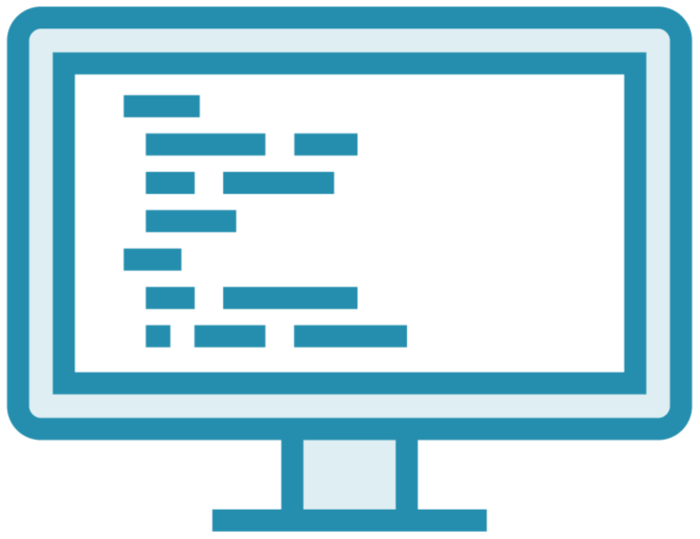
What Can You Do with .NET?
.NET 6
Notes:
So what can you build with .NET? Well, the simple answer is almost anything.
You can start with simple apps and learn some basics, which is what we will do in this course with F#.
But you can build all kinds of applicaitons,
Such as desktop apps with graphical user interfaces
But .NET has got you covered, and can grow with you to build all sorts of applications including desktop applications with a graphical interface, cloud apps, web applications, games, mobile applications, and even AI, or applications powered with artificial intelligence. .NET is quite frankly huge.
When we are building applications with .NET, we are tapping into the entire ecosystem that will help you with all your endeavors. .NET contains several languages that we can use to write our code. There's a very extensive set of libraries that you can use, which offers a lot of functionalities that's already been created for you, both from Microsoft and from the community. And finally, .NET comes with several tools that you can use to create your applications. Tools are available for all environments including Windows, Mac, and Linux, thus giving everyone the ability to write .NET applications. In this course, we are using .NET 6. One of the cool things about .NET 6 is that it can run everywhere. .NET 6 is what we call cross‑platform. It is not tied to just Windows, for example. So just like the tools we use to create them, the applications we create with .NET can run on Windows, Linux, and Mac. As I just mentioned, there are different languages available to write your .NET applications, one of them being C#. In this course, we will be using C# 10. Other languages include Visual Basic and F#. To follow along with this course on C#, no previous knowledge about the language is required. This course will teach you everything you need to know right from the very beginning, so this course is aimed at learning how to write .NET applications with C#. If you're coming from another language like Java or C++, this course will be a great fit too, to help you gain the required knowledge to write C# applications. I will assume only some very basic understanding of programming concepts, but again, just the very basics. If you don't have these yet, or are in doubt, no worries, we've got you covered. We have an amazing course here on Pluralsight called What Is Programming, of which you can see the link here on the slide. Take a look at this course if you want to understand the basics about computer programming. Through this course, we will be building a few applications together. How great is that? And all of these are focused on one of our customers, Bethany. She runs a store where she sells the most amazing pies, called Bethany's Pie Shop, and we are building the software for her business. We will be looking at some applications to manage her staff throughout this course. The concepts used in this course include employees, managers, wages, taxes, and so on, so pretty general concepts that should be clear to understand. I am a big fan of doing rather than watching a course. For that reason, the entire course is built so that you can follow along with everything I'm doing. Please, try to write the code I am writing. You will learn a lot this way. To be able to follow along, you'll need the exercise files, which you can find here on the Pluralsight website. Head over to the Exercise files tab to start the download. Oh, and before I forget, please post any questions you may have under the Discussion tab. I'm happy to help with any issue you encounter with this course. This course was created using C# 10, which is, at the time of the recording of this course, the latest version. C# is part of .NET and so we are, again, using the latest version here too, which is, as mentioned, .NET 6. We will soon talk about the different options you have to create your applications. I'm using the latest version of Visual Studio, which is the 2022 edition, and I'm using the free edition named the Community Edition. All coding samples will run perfectly fine if you use the same version that I'm using. However, nearly all C# features that we will be using in this course will work fine with older versions too. I won't be going into any detail about what works where, since that would be a tedious task, but as said, most samples will run fine with older versions too. I do recommend, if possible, to work with a new version of the tools and language, like we are doing here. .NET and C# evolve quickly nowadays, so it's best not to stay behind. With all of this out of the way, we're ready to start learning C#, so let's get our hands dirty, shall we? We now already know a bit about .NET, so it's time to learn a bit more about what C# is, and we'll do that in the first part called Hello C#. I did mention I hope you follow along with me during this course, and I will therefore make sure that you have everything you need, so we'll set up your machine next. With the tools installed, we will create our first C# program together and we'll understand the basics of the C# language already. Sadly, while writing code, we'll make errors and we'll introduce bugs in our code. Those can be nasty to find, but we're in luck. .NET comes with a great debugger that will help us greatly to pinpoint errors in our applications, and I'll show you how to use this next. We can also create applications using a CLI, a command line interface, that is. I will show you this alternative option here as well. Finally, understanding how to find things you don't know is hugely important, so in the last part of this module we'll explore the wonderful .NET docs, which are indispensable when learning about C# and .NET. I am excited to get started, and I hope you are too. Let us dive in.

Slide 11

What Can You Do with .NET?
.NET 6
Notes:
Cloud apps
But .NET has got you covered, and can grow with you to build all sorts of applications including desktop applications with a graphical interface, cloud apps, web applications, games, mobile applications, and even AI, or applications powered with artificial intelligence. .NET is quite frankly huge.
When we are building applications with .NET, we are tapping into the entire ecosystem that will help you with all your endeavors. .NET contains several languages that we can use to write our code. There's a very extensive set of libraries that you can use, which offers a lot of functionalities that's already been created for you, both from Microsoft and from the community. And finally, .NET comes with several tools that you can use to create your applications. Tools are available for all environments including Windows, Mac, and Linux, thus giving everyone the ability to write .NET applications. In this course, we are using .NET 6. One of the cool things about .NET 6 is that it can run everywhere. .NET 6 is what we call cross‑platform. It is not tied to just Windows, for example. So just like the tools we use to create them, the applications we create with .NET can run on Windows, Linux, and Mac. As I just mentioned, there are different languages available to write your .NET applications, one of them being C#. In this course, we will be using C# 10. Other languages include Visual Basic and F#. To follow along with this course on C#, no previous knowledge about the language is required. This course will teach you everything you need to know right from the very beginning, so this course is aimed at learning how to write .NET applications with C#. If you're coming from another language like Java or C++, this course will be a great fit too, to help you gain the required knowledge to write C# applications. I will assume only some very basic understanding of programming concepts, but again, just the very basics. If you don't have these yet, or are in doubt, no worries, we've got you covered. We have an amazing course here on Pluralsight called What Is Programming, of which you can see the link here on the slide. Take a look at this course if you want to understand the basics about computer programming. Through this course, we will be building a few applications together. How great is that? And all of these are focused on one of our customers, Bethany. She runs a store where she sells the most amazing pies, called Bethany's Pie Shop, and we are building the software for her business. We will be looking at some applications to manage her staff throughout this course. The concepts used in this course include employees, managers, wages, taxes, and so on, so pretty general concepts that should be clear to understand. I am a big fan of doing rather than watching a course. For that reason, the entire course is built so that you can follow along with everything I'm doing. Please, try to write the code I am writing. You will learn a lot this way. To be able to follow along, you'll need the exercise files, which you can find here on the Pluralsight website. Head over to the Exercise files tab to start the download. Oh, and before I forget, please post any questions you may have under the Discussion tab. I'm happy to help with any issue you encounter with this course. This course was created using C# 10, which is, at the time of the recording of this course, the latest version. C# is part of .NET and so we are, again, using the latest version here too, which is, as mentioned, .NET 6. We will soon talk about the different options you have to create your applications. I'm using the latest version of Visual Studio, which is the 2022 edition, and I'm using the free edition named the Community Edition. All coding samples will run perfectly fine if you use the same version that I'm using. However, nearly all C# features that we will be using in this course will work fine with older versions too. I won't be going into any detail about what works where, since that would be a tedious task, but as said, most samples will run fine with older versions too. I do recommend, if possible, to work with a new version of the tools and language, like we are doing here. .NET and C# evolve quickly nowadays, so it's best not to stay behind. With all of this out of the way, we're ready to start learning C#, so let's get our hands dirty, shall we? We now already know a bit about .NET, so it's time to learn a bit more about what C# is, and we'll do that in the first part called Hello C#. I did mention I hope you follow along with me during this course, and I will therefore make sure that you have everything you need, so we'll set up your machine next. With the tools installed, we will create our first C# program together and we'll understand the basics of the C# language already. Sadly, while writing code, we'll make errors and we'll introduce bugs in our code. Those can be nasty to find, but we're in luck. .NET comes with a great debugger that will help us greatly to pinpoint errors in our applications, and I'll show you how to use this next. We can also create applications using a CLI, a command line interface, that is. I will show you this alternative option here as well. Finally, understanding how to find things you don't know is hugely important, so in the last part of this module we'll explore the wonderful .NET docs, which are indispensable when learning about C# and .NET. I am excited to get started, and I hope you are too. Let us dive in.

Slide 12

What Can You Do with .NET?
.NET 6
Notes:
Web applications

Slide 13

What Can You Do with .NET?
.NET 6
Notes:
Games

Slide 14
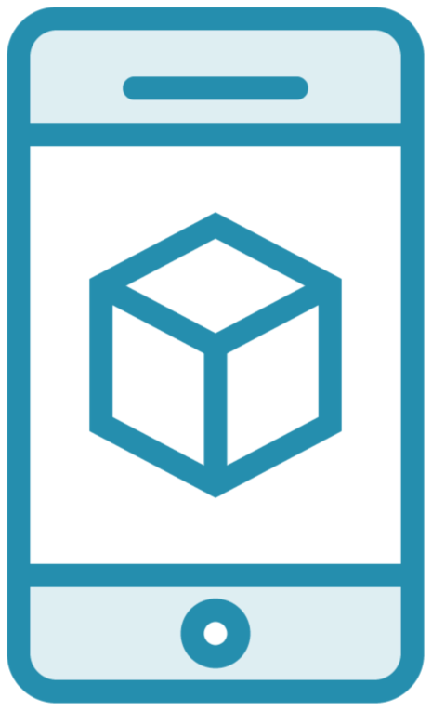
What Can You Do with .NET?
.NET 6
Notes:
Mobile apps

Slide 15

What Can You Do with .NET?
.NET 6
Notes:
AI

Slide 16

What Can You Do with .NET?
.NET 6
Notes:
FInancial

Slide 17

What Can You Do with .NET?
.NET 6
Notes:
And data science
F# is really popular in the services, finance and data science

Slide 18



The .NET Ecosystem
Languages
Libraries
Tools
Notes:
.NET is quite frankly huge.
When building apps with .NET, and also with F#, you get access to the whole ecosystem of .NET to assist you.
This includes several programming languages, that fit different needs, primarily OO and functional, as well see the later with F#.
There's a huge set of existing libraries and open source projects available. And honestly, this has been one of the great areas of growth and strength with .NET since becoming cross platform and open source. The selection of libraries available are robust and let you focus on just building your business logic.
And there are a great set of both free and for pay tools that can be used to build apps, and across windows, mac and linux.

Slide 19
.NET 6
Cross-platform
Notes:
In this course, we are using .NET 6, and F# version 6.
.NET 6 is truly cross platform and can run anywhere. Dependendies on windows that were in previous versions have been complete removed. Tools exist for each platform, and the apps built with it can run on all of them too.

Slide 20

The Languages of .NET
F#
C#
Visual Basic
Notes:
We will be focusing on F#, but there are multiple languages on .NET to write code with.
F# is it the functional language
C# is OO
And VB is also OO

Slide 21

No F# knowledge is required
Notes:
To follow along with this course, you will not need any knowledge of F#.
This course will teach you everything you need to know from the ground up and is aimed at learning the foundations of F# apps on .NET.
If you have knowledge of other programming languages, in particular C#, then that will help, along with having some fundamental knowledge of the .NET platform.
But F# is functional in nature, and hence the way things are done in the language are often very different from OO and languages such as C#. But having some exposure to them is convenient as a point of contrast.

Slide 22

The Bank System
- Bank account management software
Notes:
During this course I’ll go over many demos that demonstrate the concepts of F# and functional programming.
But we will also build an application together to demonstrate F# in practice.
Through this course, we will be building a few applications together. How great is that? And all of these are focused on one of our customers, Bethany. She runs a store where she sells the most amazing pies, called Bethany's Pie Shop, and we are building the software for her business. We will be looking at some applications to manage her staff throughout this course. The concepts used in this course include employees, managers, wages, taxes, and so on, so pretty general concepts that should be clear to understand.
`

Slide 23

Follow along with everything!
Notes:
I’m a big believer in learning via doing.
Nothting makes an imprint on memory like following along and writing / executing code.
All the code I show is available in the exercise files in the course content on the Pluralsight website.
So go and get those if you want to follow along.
And also, if you have questions, please ask them in the course discussion group as I love to help out in that environment and augment the learning experience.

Slide 24
This version was created using:
F# 6.0
.NET 6.0 (6.0.201)
Visual Studio Code 1.64.2
Ionide-fsharp 5.12.0
Version Check
Notes:
Recommended script:
“This slide shows the versions of [major tool, framework, language, etc.] for which the information in this course applies.”

Slide 25
This course is 100% applicable to:
F# 6.0
.NET 6.0
Visual Studio Code
Ionide-fsharp
Most code will be compatible with older versions of F# and .NET
Version Check
Notes:
Recommended script:
“This slide shows the versions of [major tool, framework, language, etc.] for which the information in this course applies.”

Slide 26
Points to be revised after mod 1 done
Overview
Notes:
With all of this out of the way, we're ready to start learning C#, so let's get our hands dirty, shall we? We now already know a bit about .NET, so it's time to learn a bit more about what C# is, and we'll do that in the first part called Hello C#. I did mention I hope you follow along with me during this course, and I will therefore make sure that you have everything you need, so we'll set up your machine next. With the tools installed, we will create our first C# program together and we'll understand the basics of the C# language already. Sadly, while writing code, we'll make errors and we'll introduce bugs in our code. Those can be nasty to find, but we're in luck. .NET comes with a great debugger that will help us greatly to pinpoint errors in our applications, and I'll show you how to use this next. We can also create applications using a CLI, a command line interface, that is. I will show you this alternative option here as well. Finally, understanding how to find things you don't know is hugely important, so in the last part of this module we'll explore the wonderful .NET docs, which are indispensable when learning about C# and .NET. I am excited to get started, and I hope you are too. Let us dive in.

Slide 27
Hello F#

Slide 28
Hello F#
.NET’s Functional Programming Language
Static typed and type safe
Functional, imperative and OO styles
OCaml-based
Notes:
F# is the is .NET’s functional programming language that runs on .NET.
It is statically typed and type safe, which means that the compiler can check that we are using types and functions correctly and find errors at compile time.
F# has its roots in the Ocaml family of langugages which provide a combination of functional, imperative and OO styles.
So if you have worked with any Ocaml based languages, F# will feel very familiar.
And if you have been using the new features of C# 10, then some concepts may feel familiar, such as record types.
That’s because as C# has evolved, it has adopted many functional programming concepts that have actually existed in F# for quite a while.
That’s why I say if you are a C# programmer, F# is great to learn as it will make you a better C# programmer by learning the functional patterns that C# ever evolves support.

Slide 29
F# Timeline
2005
2010
2012
2013
2015
2017
2018
2019
2019
2020
2021
1.0
2.0
3.0
3.1
4.0
4.1
4.5
4.6
4.7
5.0
6.0
Notes:
F# is an actively maintained programming language and has been evolving since its first version in 2005.
Although it
It is developed using an open development process with its users and Microsoft.

Slide 30
What Can I Build with F#?
Console Applications
Desktop Applications
Web Applications
Mobile Applications
Services and Microservices

Slide 31
Why Use F#?
Conciseness
Convenience
Correctness
Concurrency
Completeness

Slide 32
F# Tools

Slide 33
F# Tools
.NET SDK
Visual Studio
Visual Studio Code / Ionide-fsharp
JetBrains Rider
F# Interactive
.NET Interactive / Notebooks

Slide 34
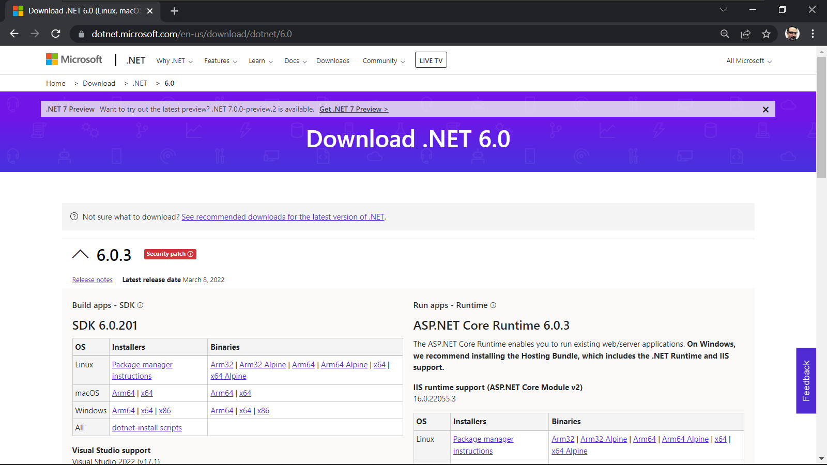
.NET 6.0 SDK

Slide 35
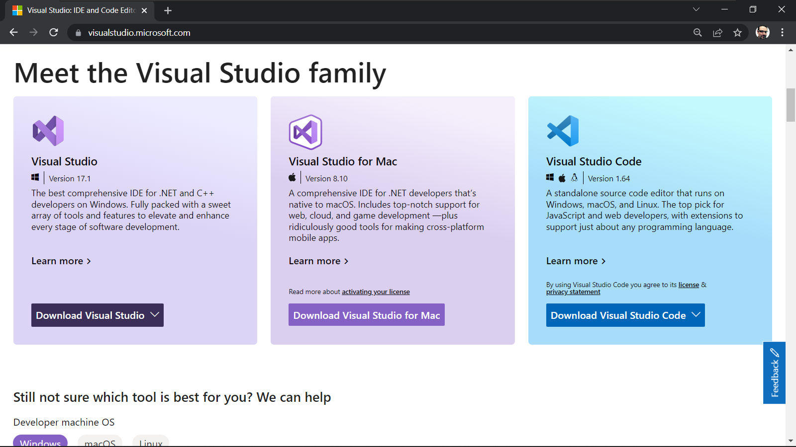
Visual Studio

Slide 36
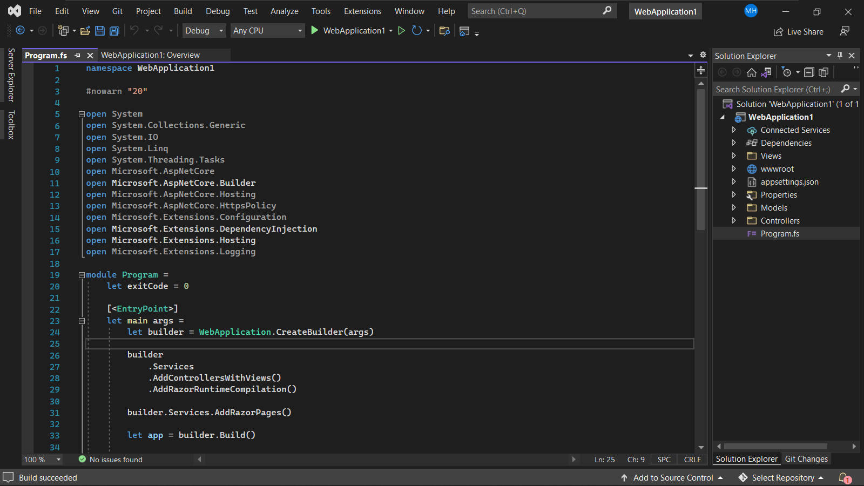
Visual Studio and F#

Slide 37
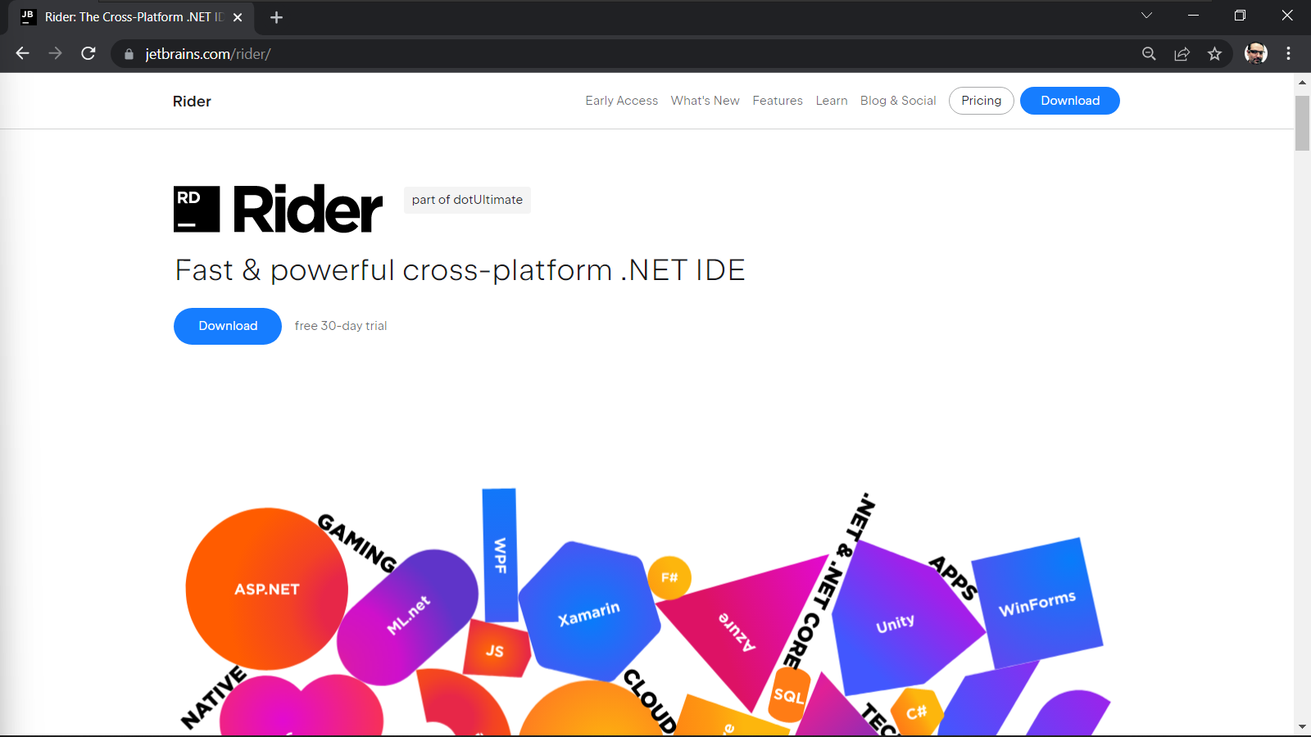
JetBrains Rider

Slide 38
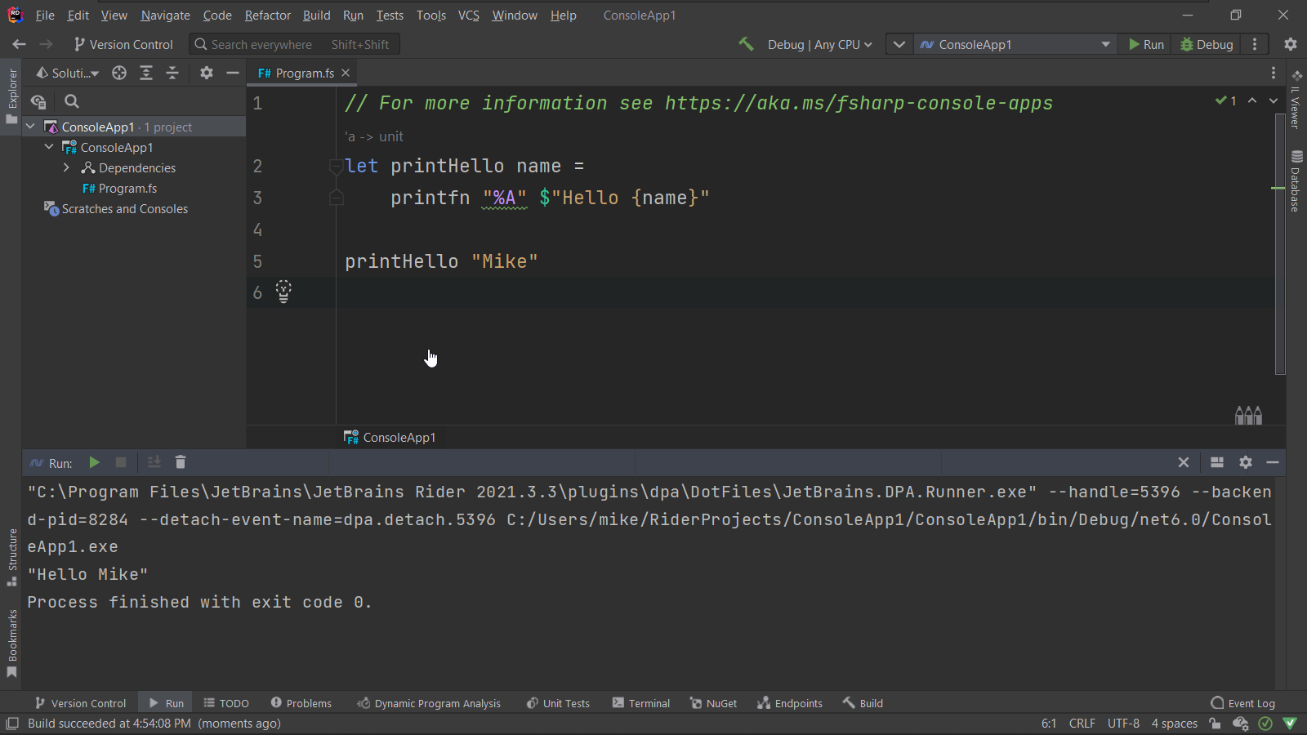
JetBrains Rider

Slide 39
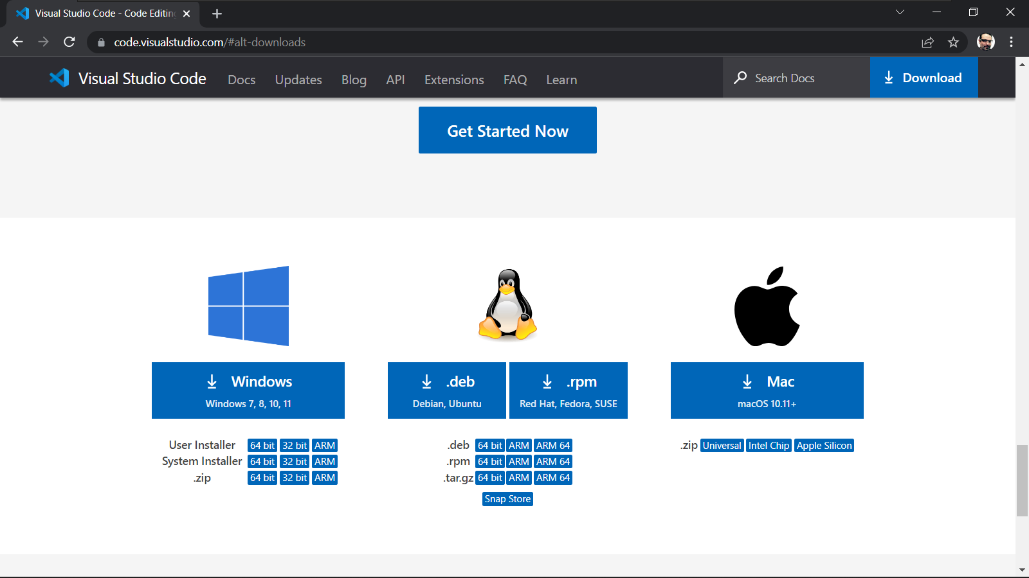
Visual Studio Code

Slide 40
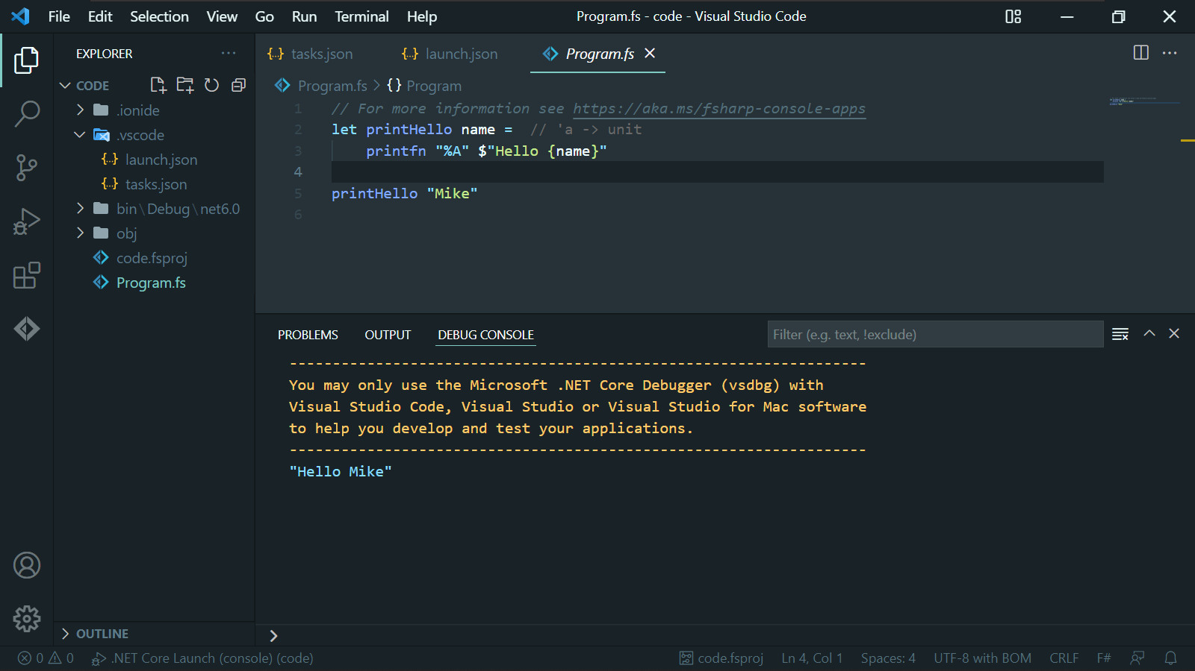
Visual Studio Code

Slide 41
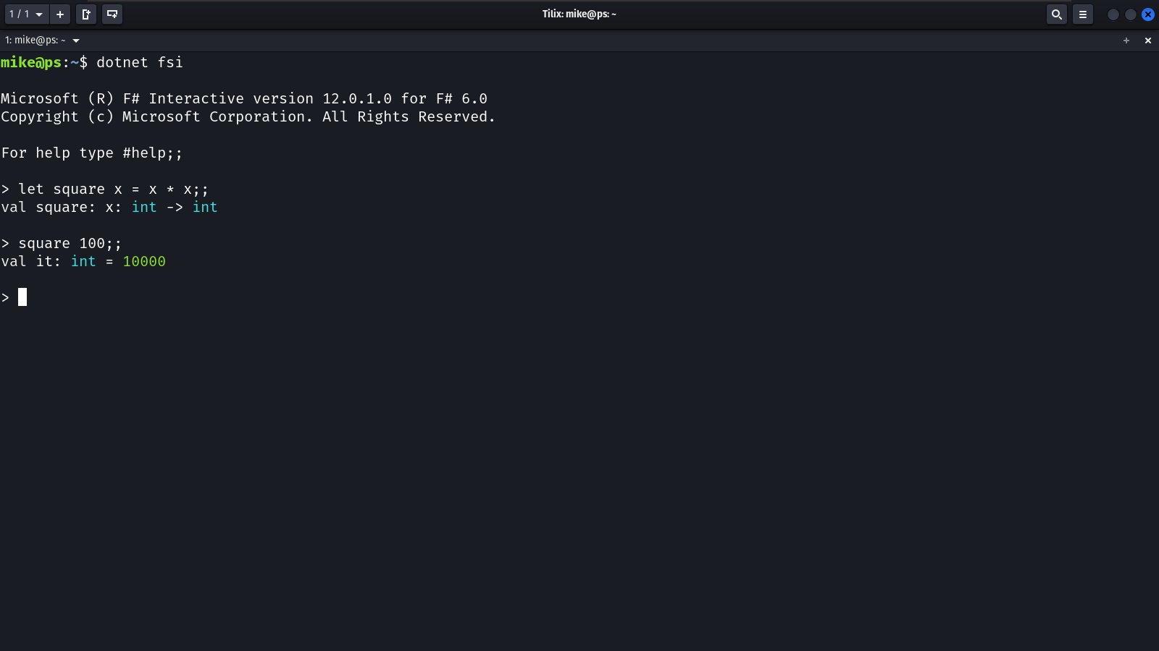
F# Interactive

Slide 42
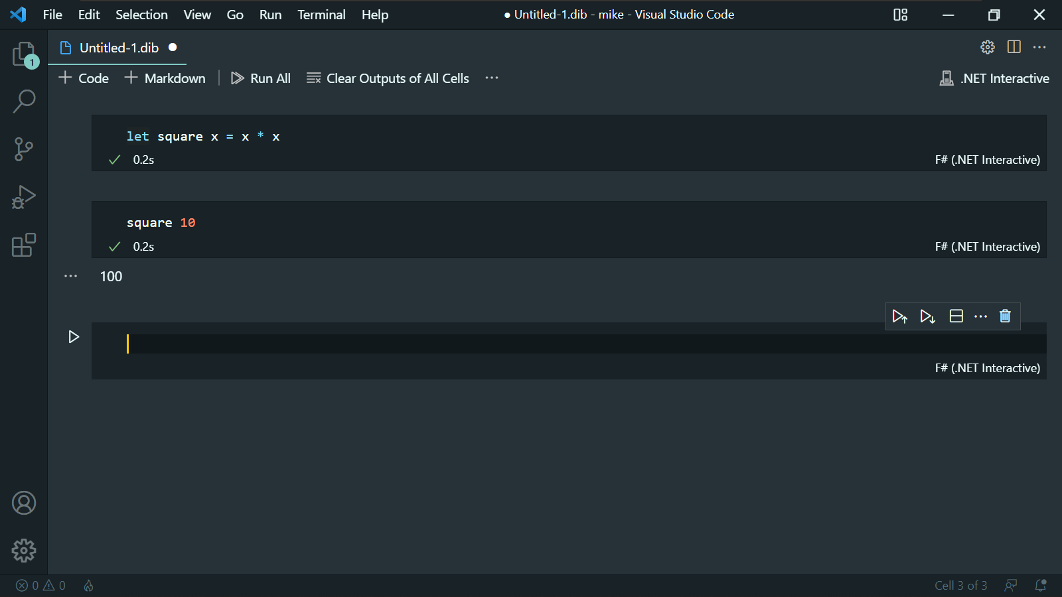
.NET Interactive

Slide 43
Configure F# Dev Environment on Windows
Install .NET 6.0 SDK
Install Visual Studio Code
Install Fsharp-Ionide

Slide 44
Configure F# Dev Environment on Ubuntu
Install .NET 6.0 SDK
Install Visual Studio Code
Install Fsharp-Ionide

Slide 45
F# and the .NET CLI

Slide 46

The .NET CLI
The command line interface for .NET
Cross-platform
Create, build and run F# .NET projects
Run F# scripts

Slide 47
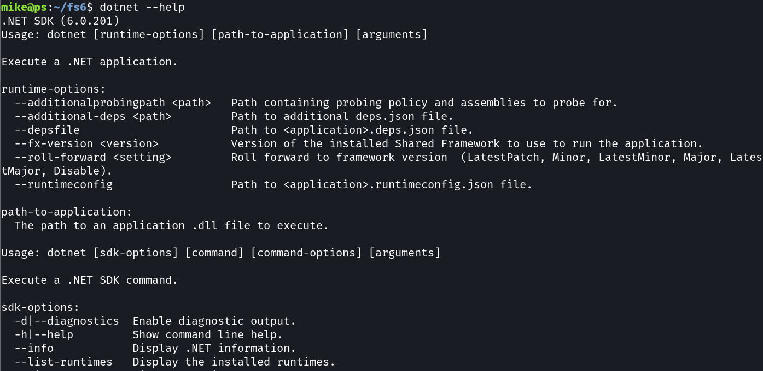
The “dotnet” Command

Slide 48
dotnet --list-runtimes
dotnet --list-sdks
dotnet new
dotnet build
dotnet run
dotnet watch
dotnet fsi
List installed .NET runtimes
List installed .NET SDK’s
Create a new project
Compile the project
Execute the project
Watch for changes in the project and build / run
Start the F# interactive terminal or run scripts

Slide 49
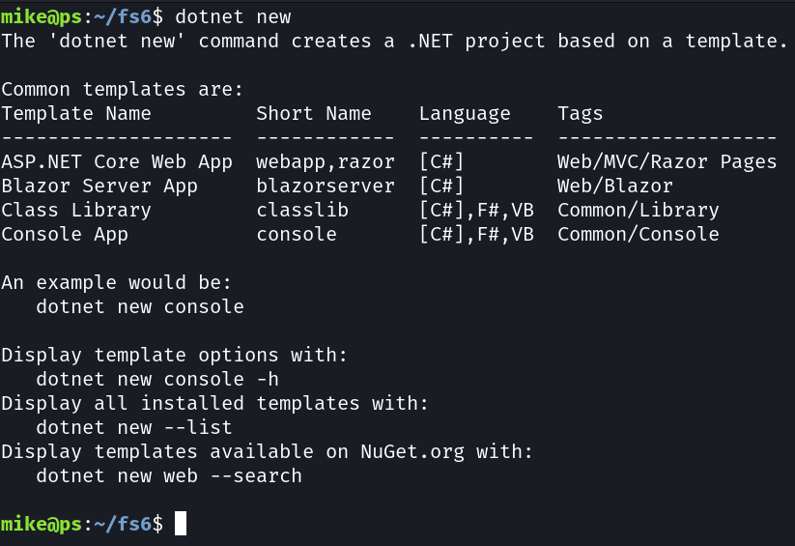
New Project

Slide 50
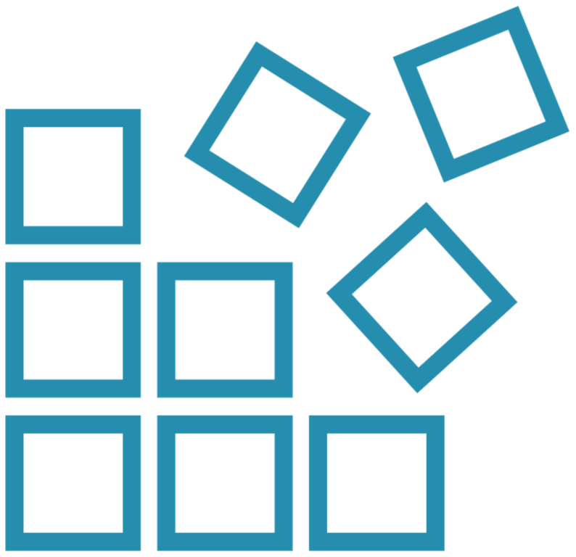

.NET F# Projects
Source Files
A project is a one or more source files that contain source code
Assemblies
Source files are compiled into assemblies that can be executed or reused

Slide 51
Create a New F# Project
dotnet new console -n fsharp1 -o src/fsharp1 -lang f#

Slide 52
Create a New F# Project
Create a new project
dotnet new console -n fsharp1 -o src/fsharp1 -lang f#

Slide 53
Create a New F# Project
dotnet new console -n fsharp1 -o src/fsharp1 -lang f#
Template

Slide 54
Create a New F# Project
Name of the project
dotnet new console -n fsharp1 -o src/fsharp1 -lang f#

Slide 55
Create a New F# Project
dotnet new console -n fsharp1 -o src/fsharp1 -lang f#
Location

Slide 56
Create a New F# Project
Use F#!
dotnet new console -n fsharp1 -o src/fsharp1 -lang f#

Slide 57
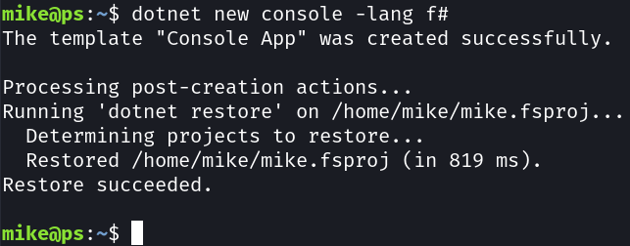
Create a New F# Project
dotnet new console -n fsharp1 -o src/fsharp1 -lang f#

Slide 58
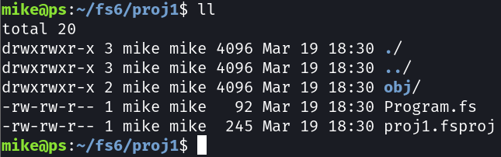
New F# Project Structure

Slide 59
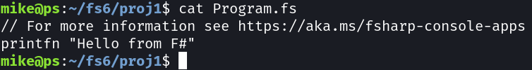
.NET 6.0 Default Application

Slide 60
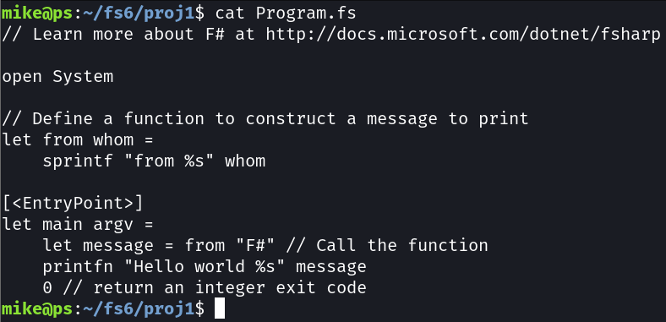
.NET 5.0 Default Application

Slide 61
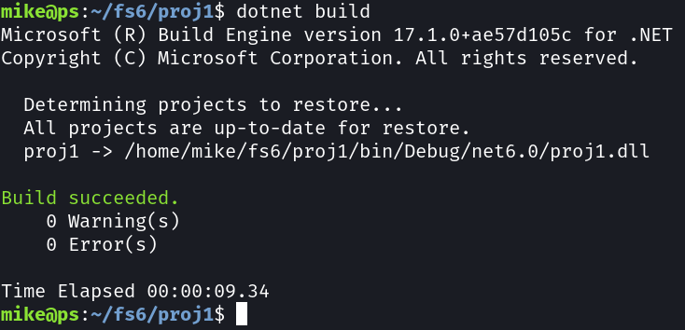
Build F# Project
dotnet build

Slide 62
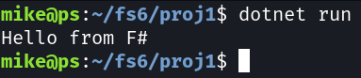
Build F# Project
dotnet run

Slide 63
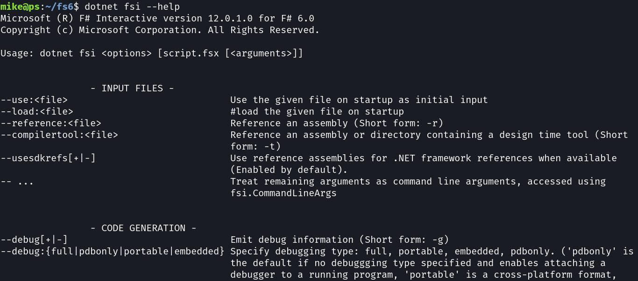
“dotnet fsi” Command

Slide 64
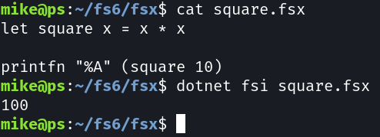
Run an F# Script
dotnet fsi [script.fsx [<arguments>]]

Slide 65
Create and run an F# console app with the CLI
Create project with “dotnet new”
Build project with “dotnet build”
Run project with “dotnet run”

Slide 66
Edit an run a console app with VS Code
Create project with “dotnet new”
Start VS Code
Configure VS Code to run F# the project

Slide 67
Debug F# with VS Code
Set breakpoints
Examine variable values

Slide 68
Use this layout to introduce or summarize
Overview
Explain what’s in this section for learners
Layout a problem that will be solved
Summary
Revisit problem and solution
Provide practical takeaways
Summary

Slide 69
Up next:
Functional Programming

Slide 70
Data and functions are separate. This is considered a benefit over OOPs.

Slide 71
F# does support objects, but primarily for interoperation with .NET

Slide 72
F# is executed from beginning of file to end. Only code earlier in the file can be referenced.

Slide 73
F# is declarative – what to do Not imperative – how to do it

Slide 74
F# uses whitespace for scoping instead of brackets {}

Slide 75
F# 6 Fundamentals
Foundations of Functional Programming with F#
Michael Heydt
Developer and Trainer
@mikeheydt www.smac.io

Slide 76
Topics in the module
Overview

Slide 77
F# Syntax Basics

Slide 78
Declaring a Variable

Slide 79
“do”

Slide 80
Expressions vs Statements

Slide 81
Declaring a Function

Slide 82
Conditional Expression: if..then..else

Slide 83
Reading from the Console

Slide 84
Writing to the Console

Slide 85
Entry Points

Slide 86
Classes

Slide 87
Match

Slide 88
Basic types
Type Name
.NET Type
bool
byte / sbyte
Int16 / int32 / int64, uint16 / uint32 / uint64
float32, single, float, double, decimal
char
string
unit
Boolean
Unsigned / signed byte
16, 32 and 64 bit integers
32-bit, 64-bit, and 28 digit min float
char
string
N/A

Slide 89
F# has access to all .NET types, including objects

Slide 90
Unit

Slide 91
printf / printfn
Format specifier
Meaning
%A
%s
%c
%d, %i
%f, %F
%b
%%
Any value
String
Char
Decimal integer
Floating point
Boolean (output ‘true’ or ‘false’)
Just a ‘%’

Slide 92
Strings
// Using a verbatim string
let xmlFragment1 = @"<book author=""Milton, John"" title=""Paradise Lost"">"
// Using a triple-quoted string
let xmlFragment2 = """<book author="Milton, John" title="Paradise Lost">"""
Information about the code above. Code should be in Roboto Mono font, while slide title and supplemental text should remain in PS TT Commons.

Slide 93
Matching patterns: arrays

Slide 94
Class Definition
type MyClass(a) =
let field1 = a
let field2 = "text"
do printfn "%d %s" field1 field2
member this.F input =
printfn "Field1 %d Field2 %s Input %A" field1 field2 input

Slide 95
Comparison: F# if vs C#
F#
C#

Slide 97
Functional Programming Concepts

Slide 98
Four Key Concepts of F#
Function Oriented
Not object-oriented
Expressions
Rather than statements
Algebraic Types
For domain models
Pattern Matching
For control flow

Slide 99
Functional Programming Concepts

Slide 100
Function
In the relational approach, a function f: X→Y is a binary relation between X and Y that associates to each element of X exactly one element of Y.
https://en.wikipedia.org/wiki/Function_(mathematics)

Slide 101
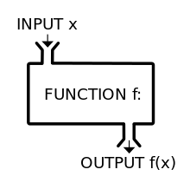
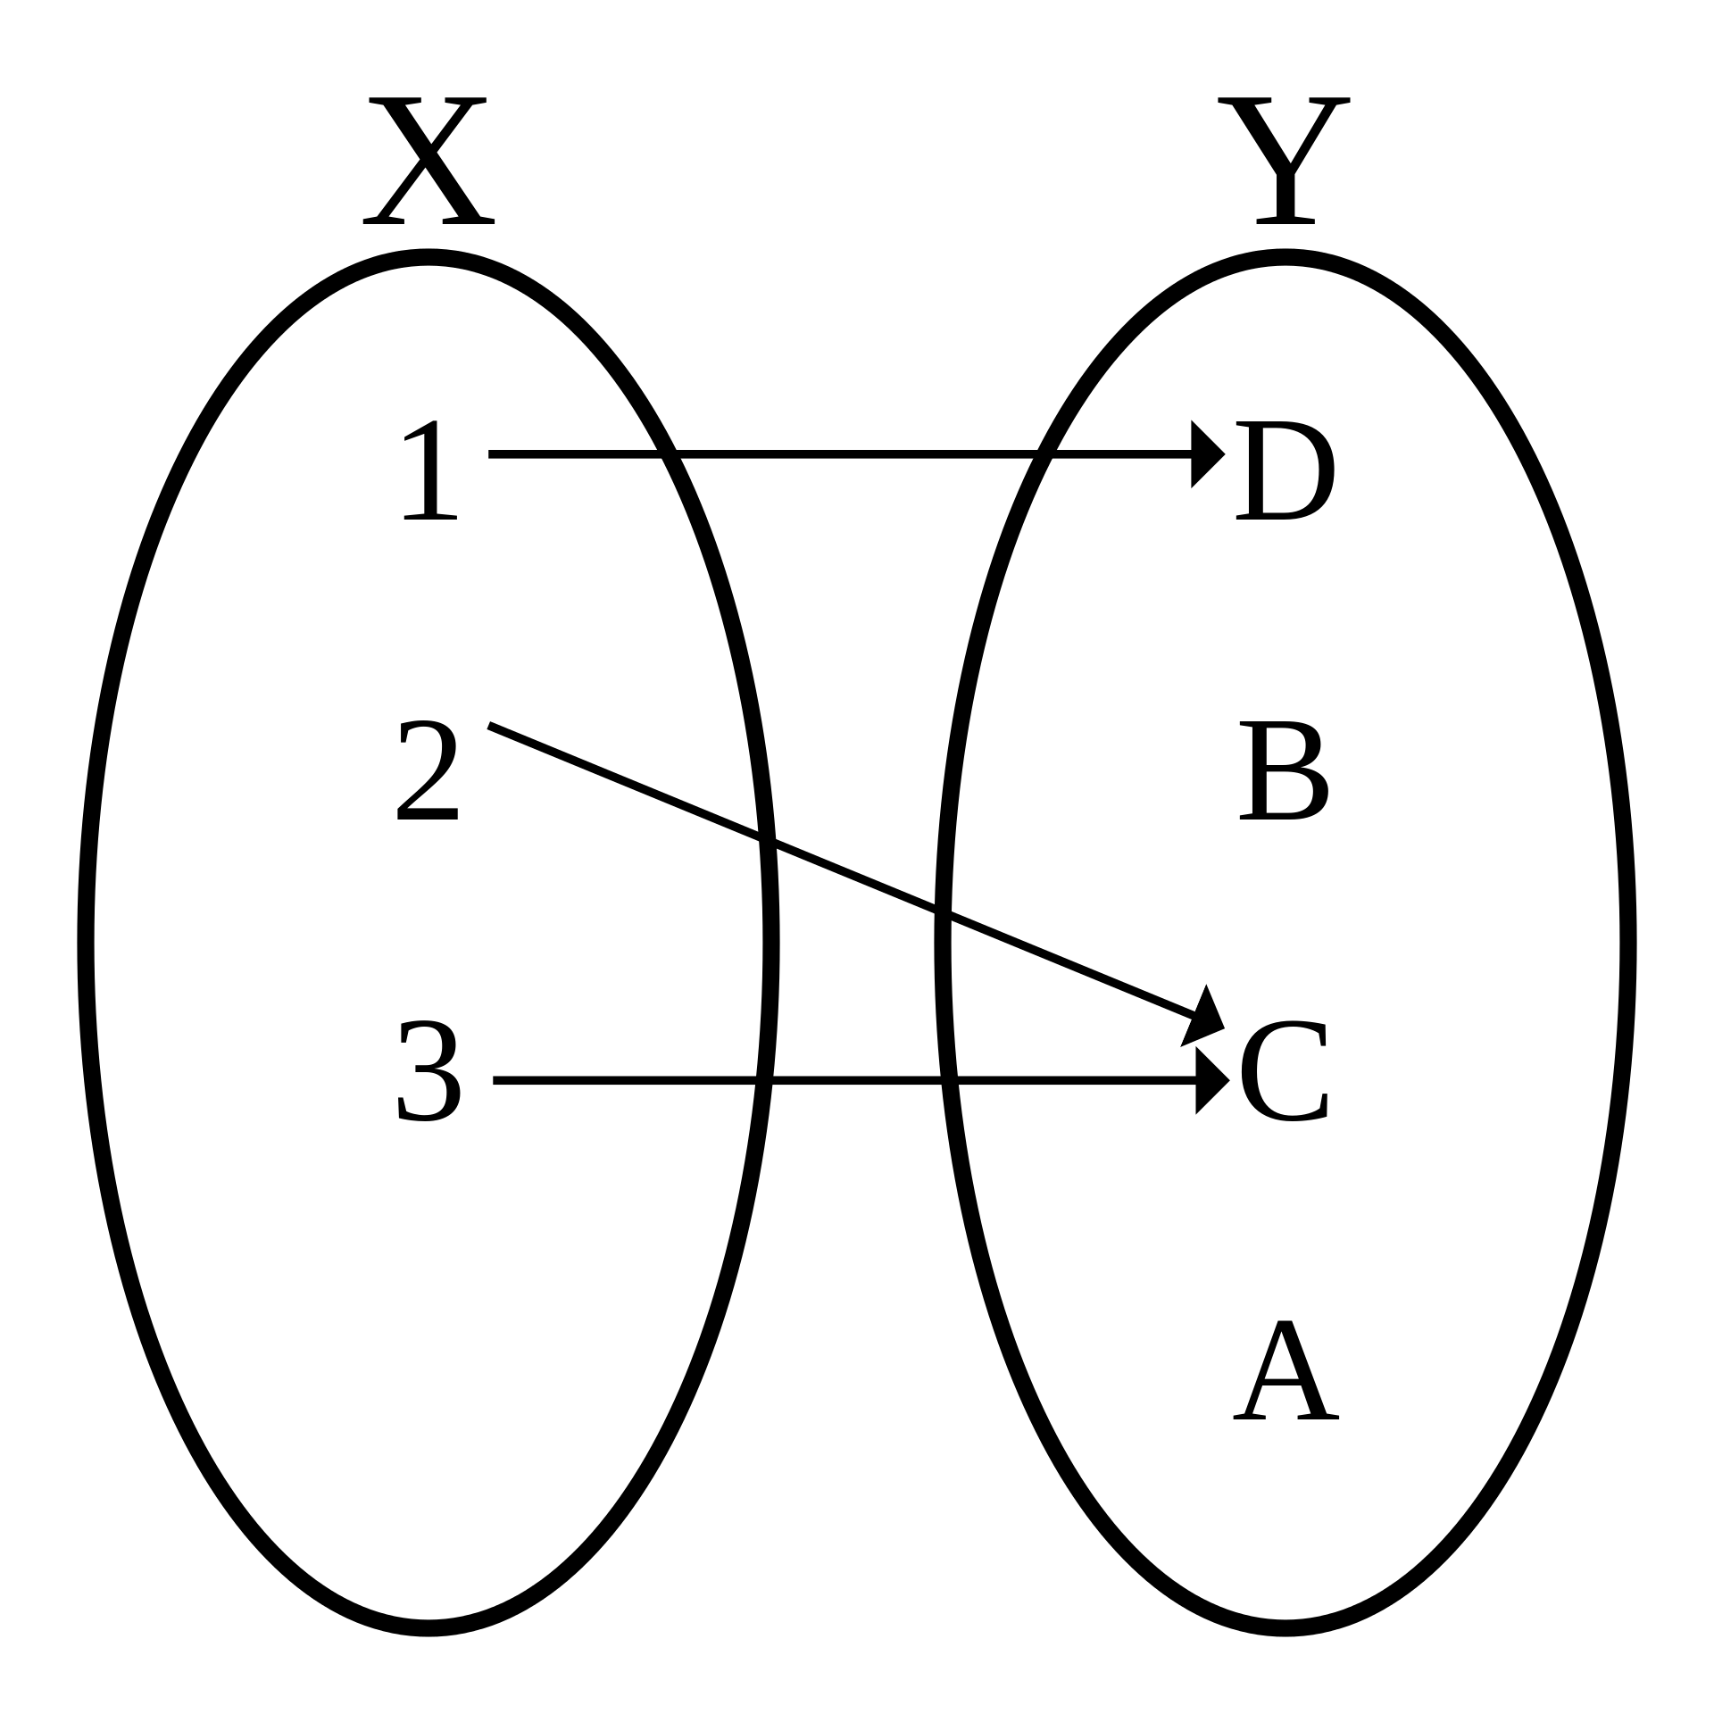
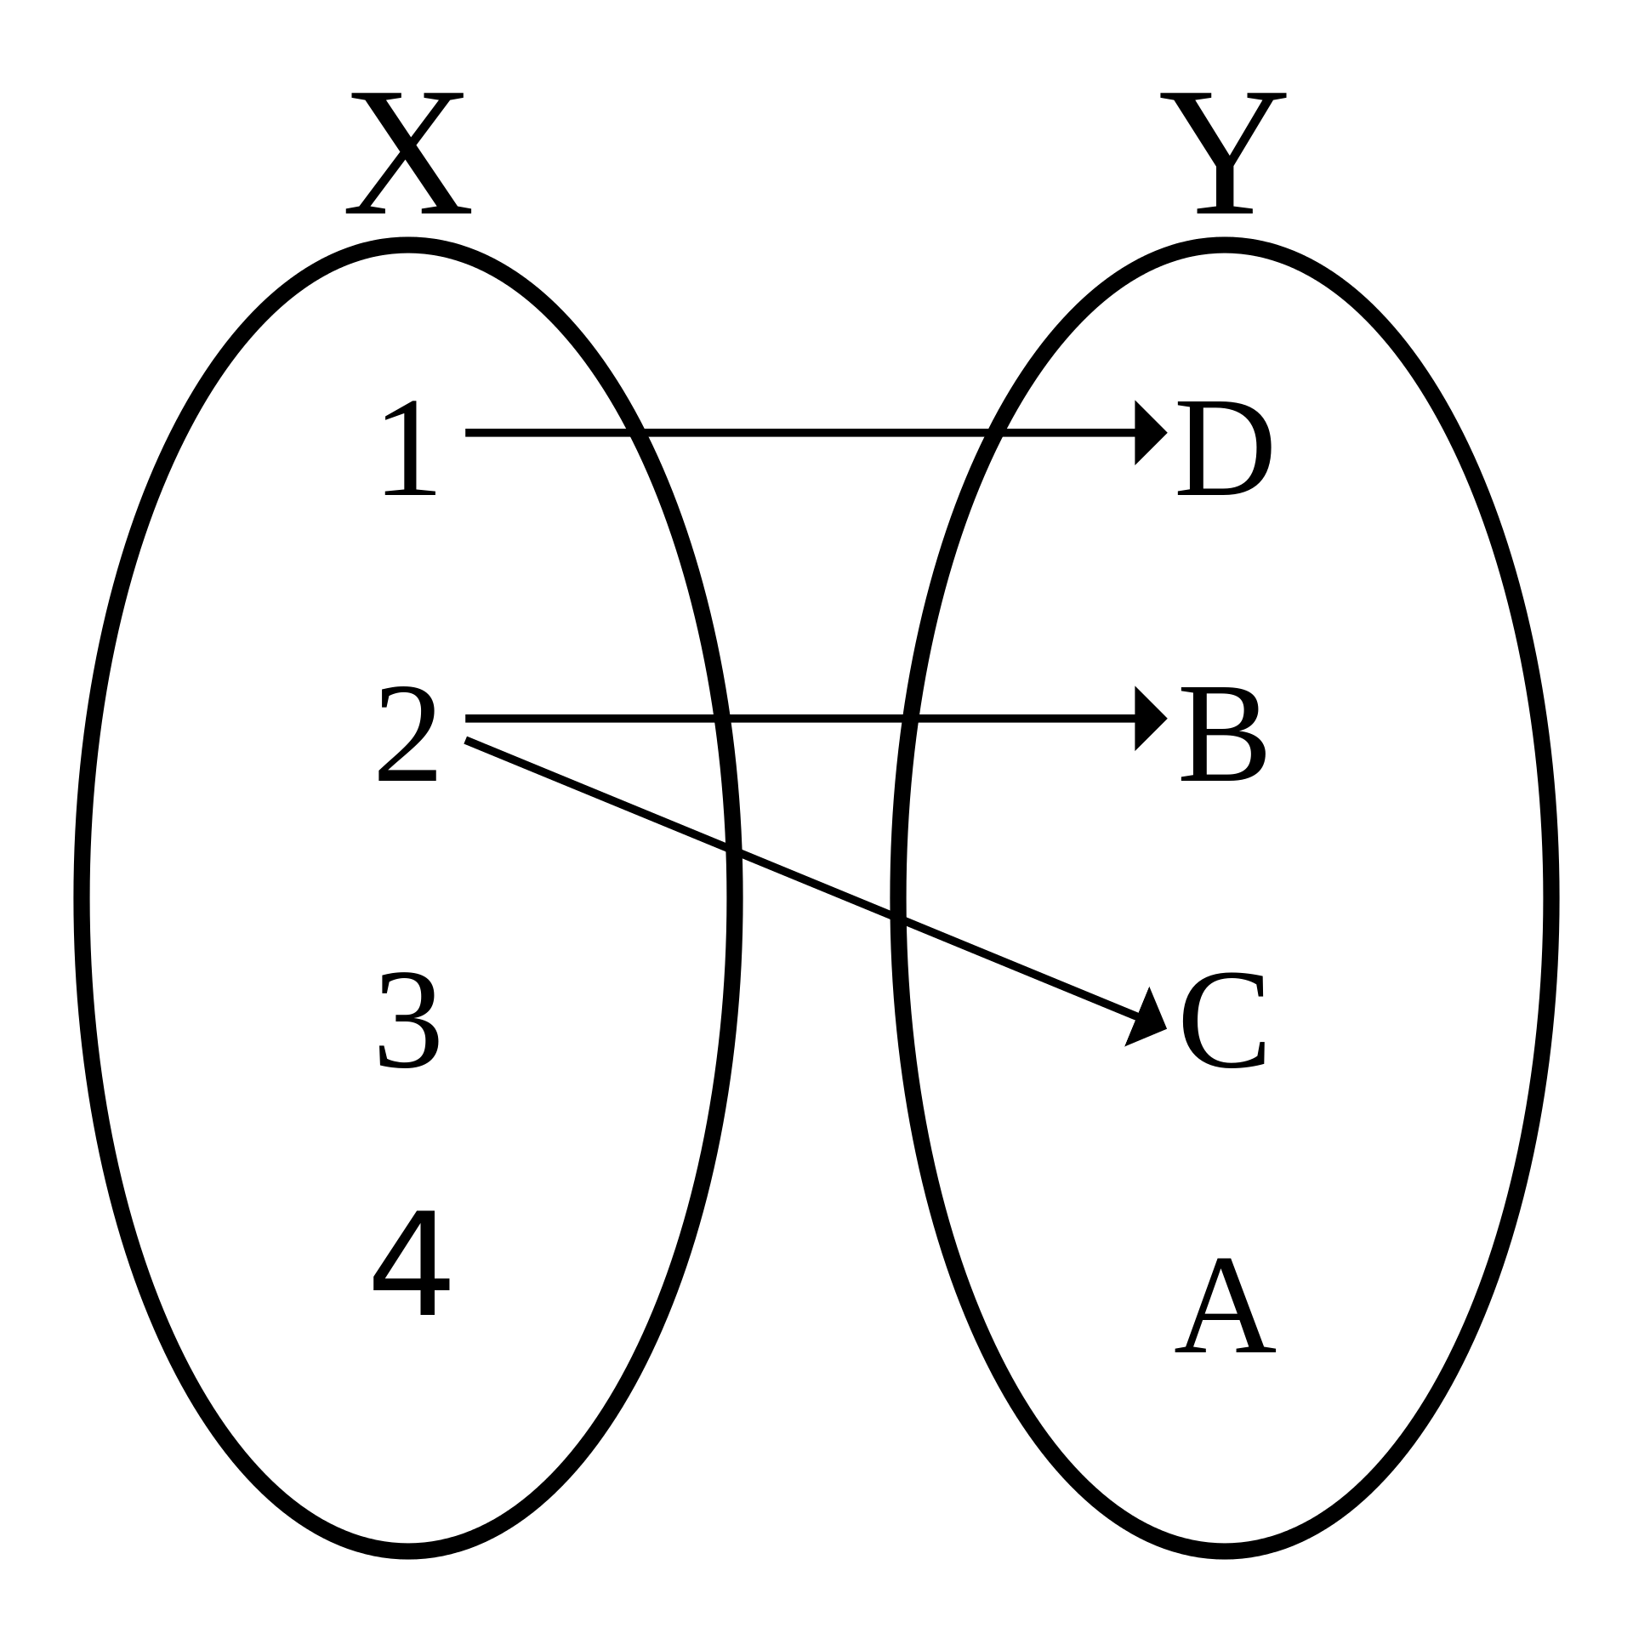
Functions
Black-box
One input
One output
Maps Domain to Range
Values in X -> Y
Not a Function
This is bad

Slide 102
Single-Valued Functions

Slide 103
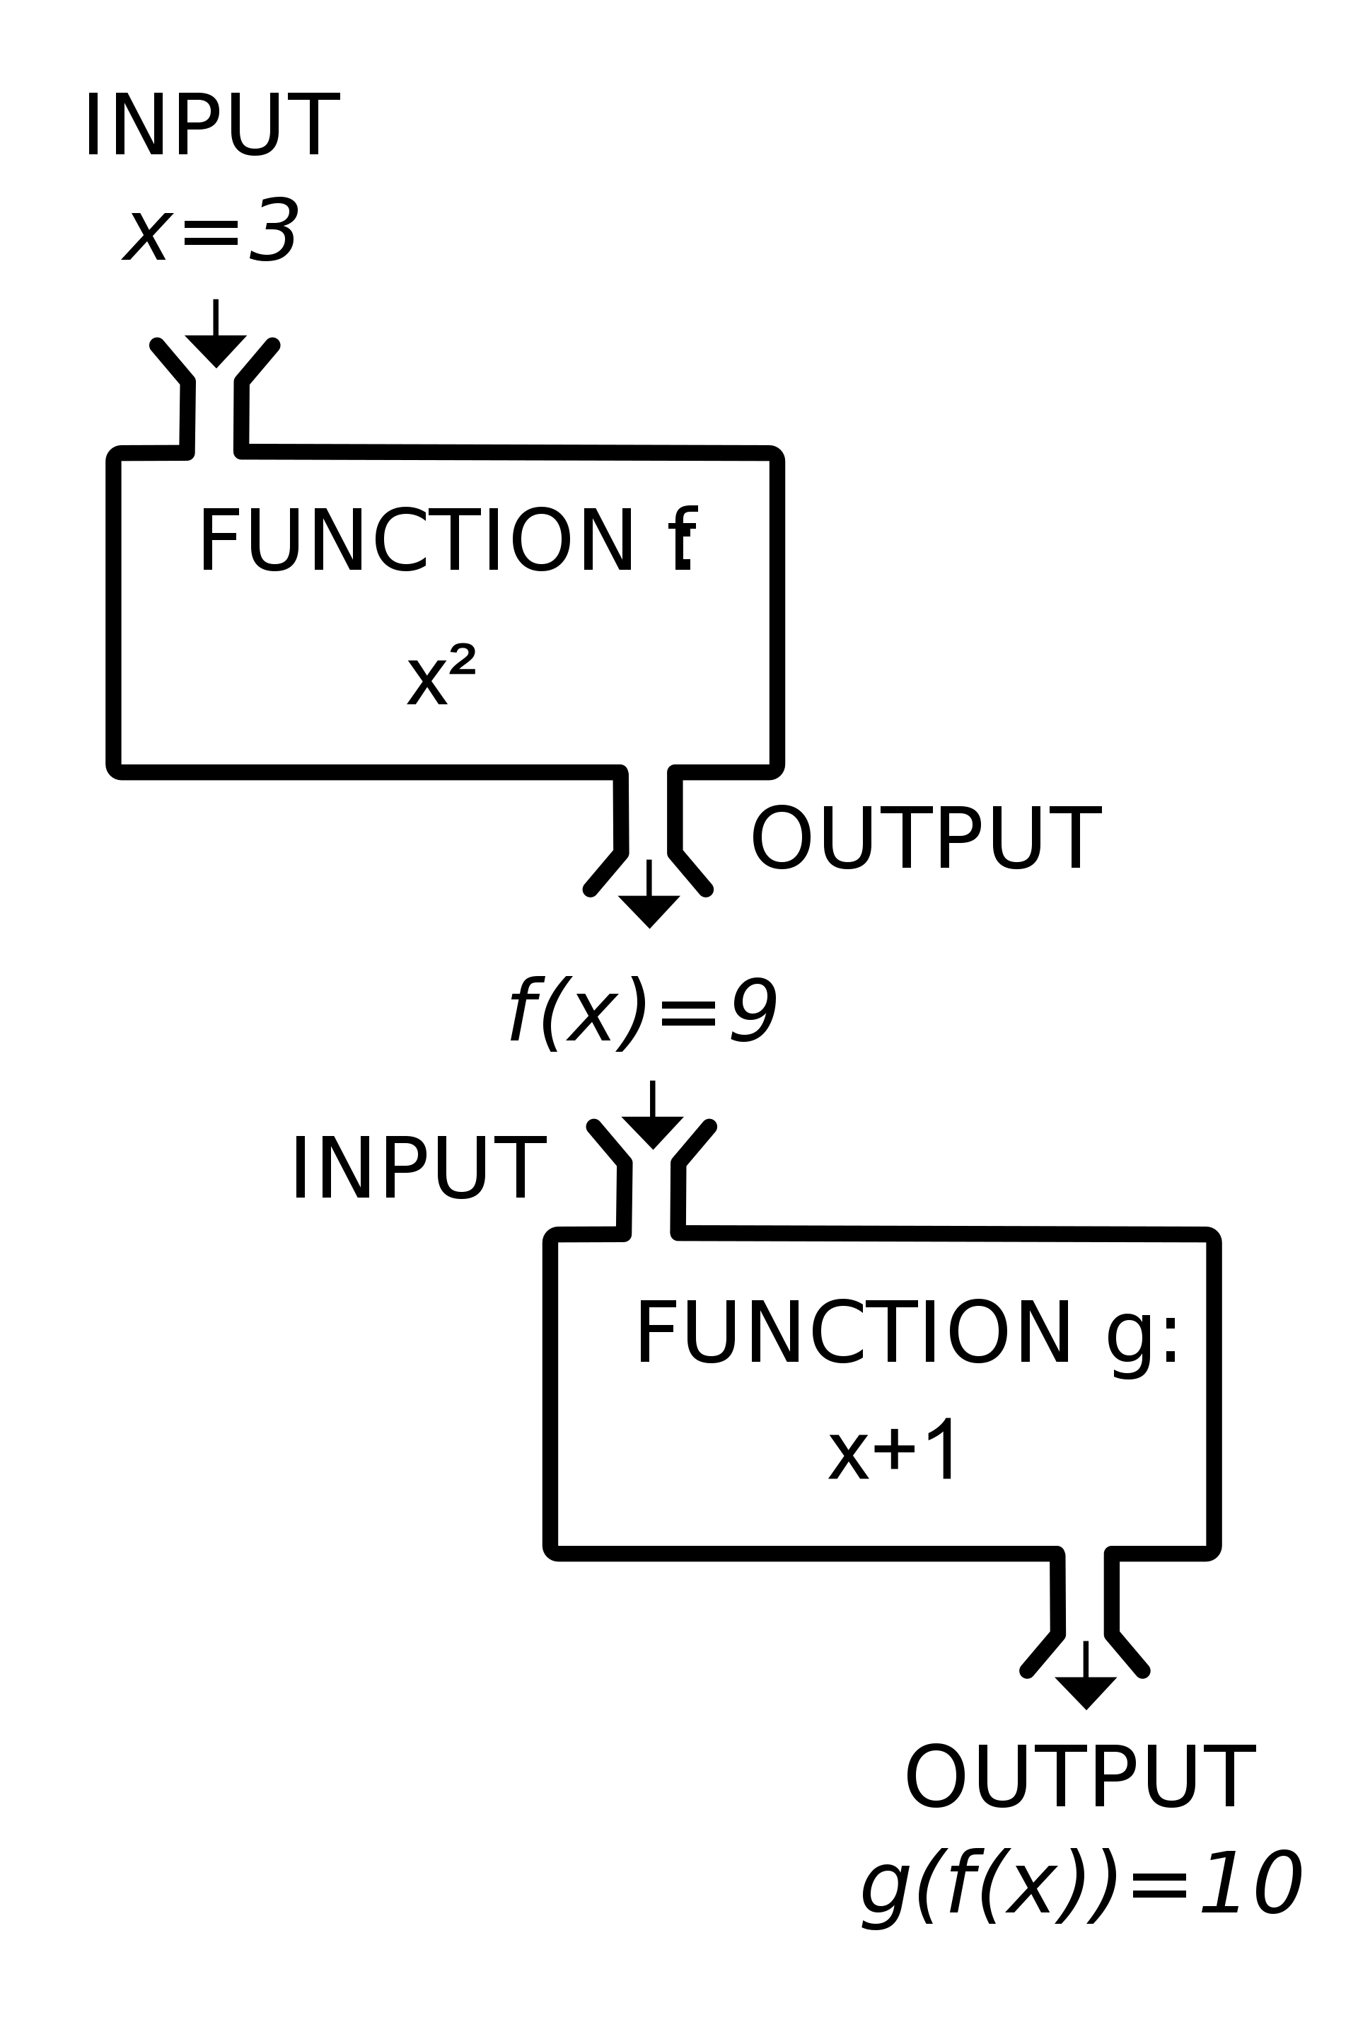
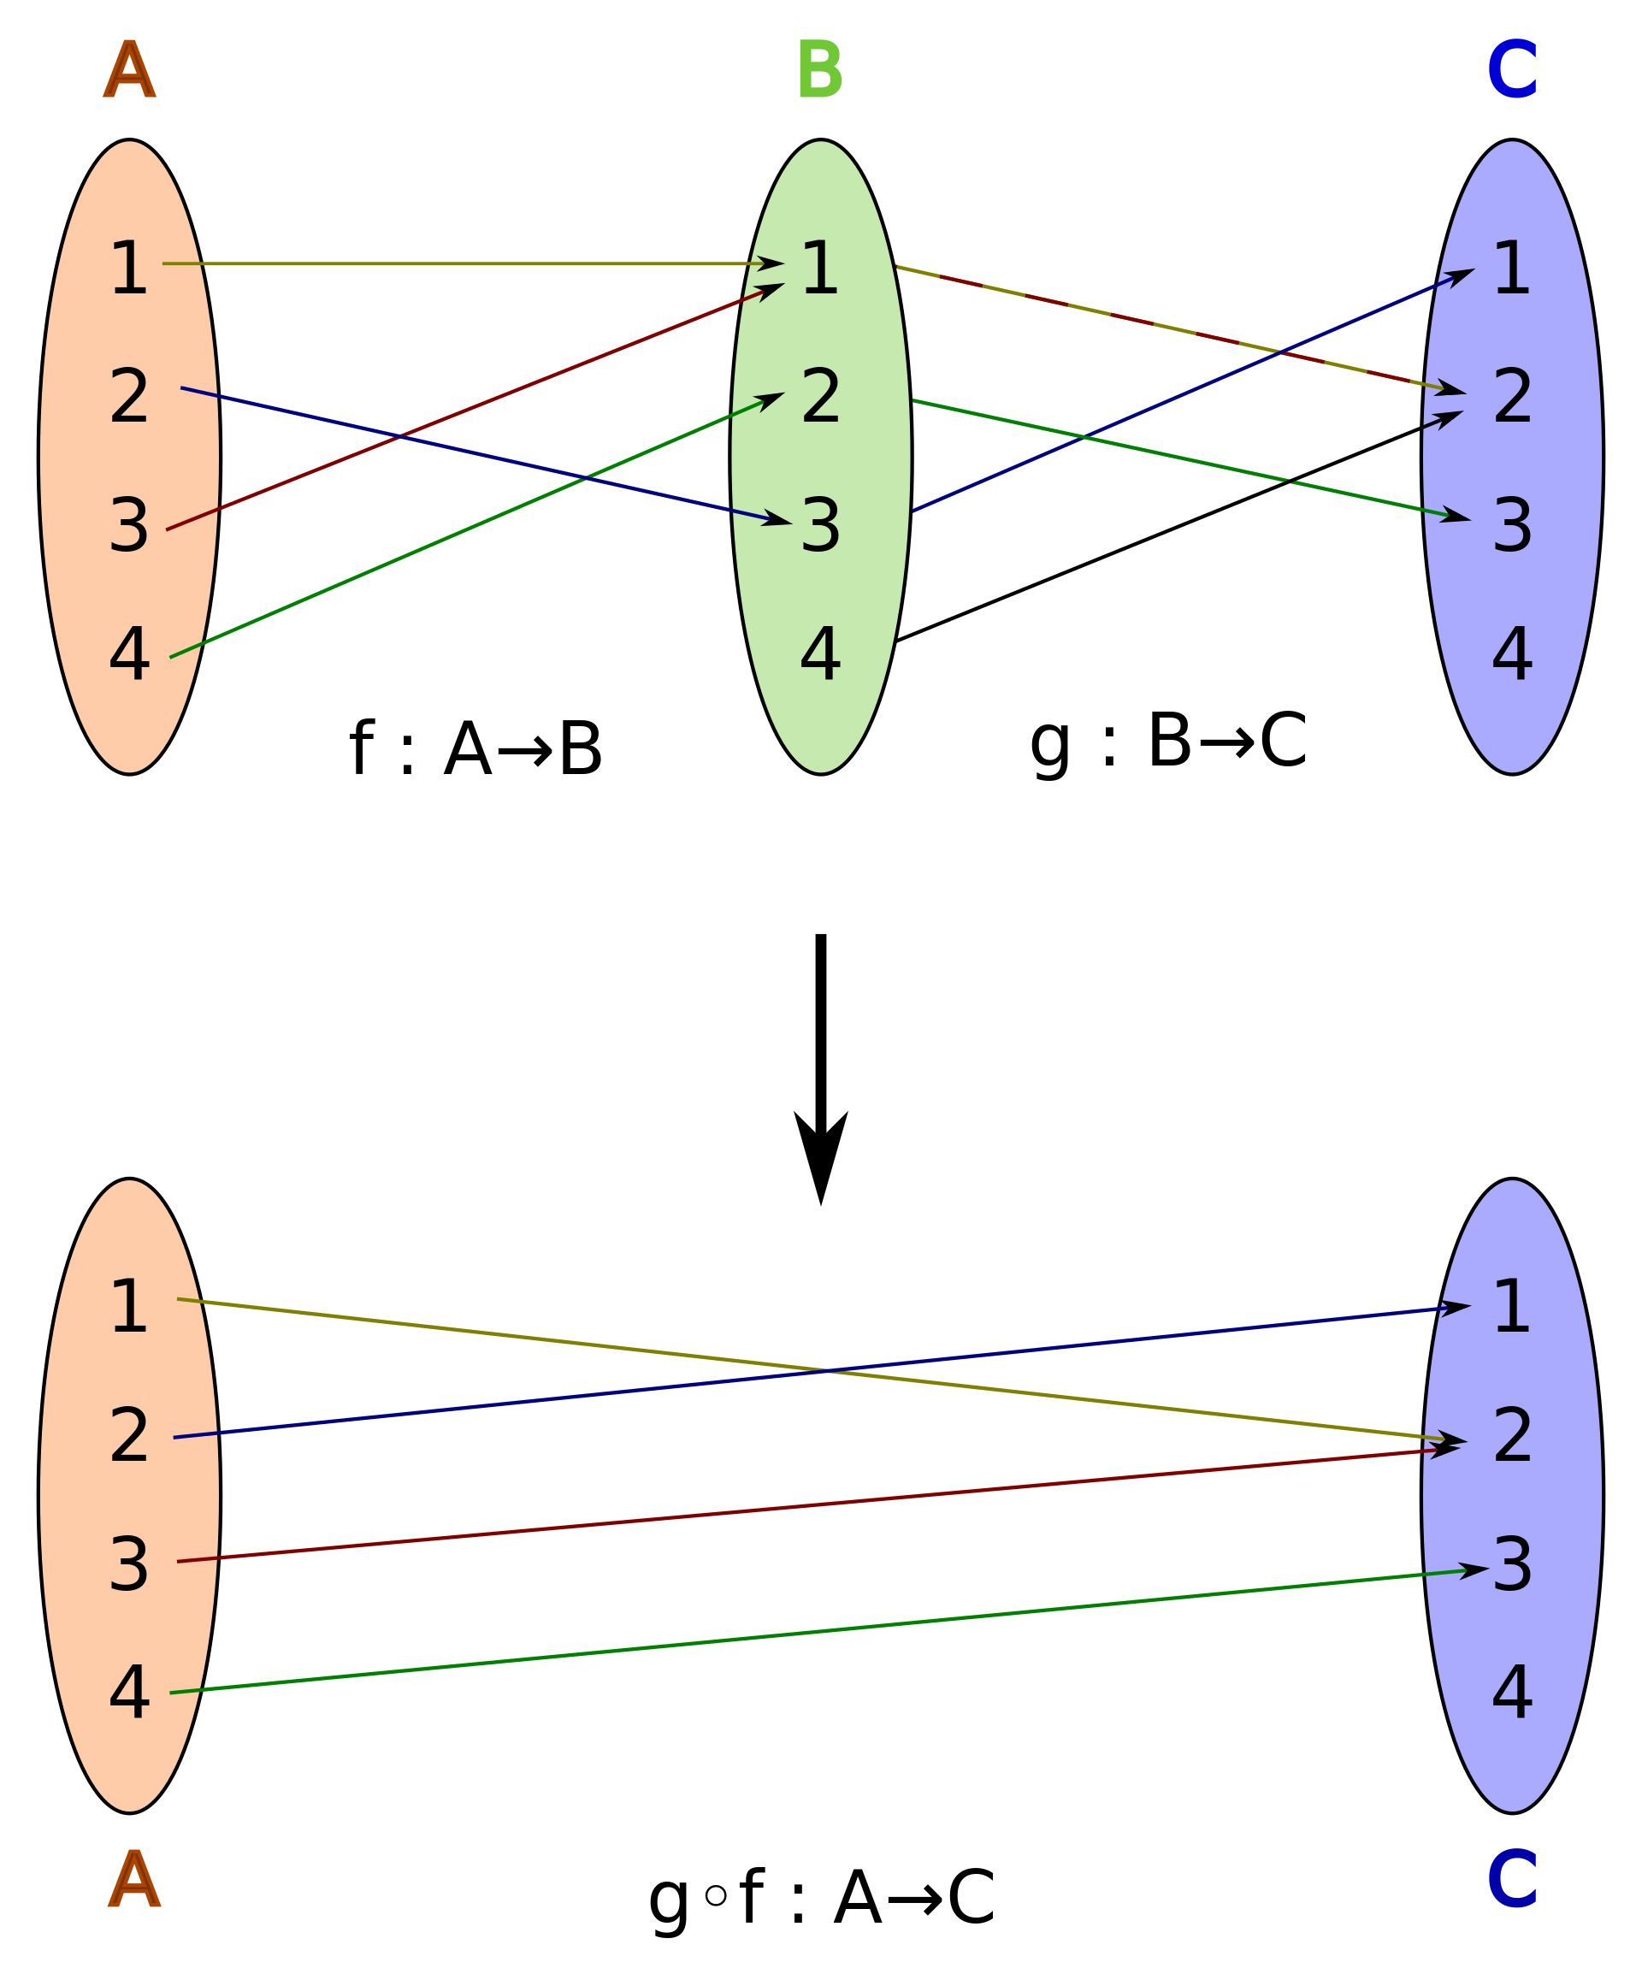
Composite Functions

Slide 104
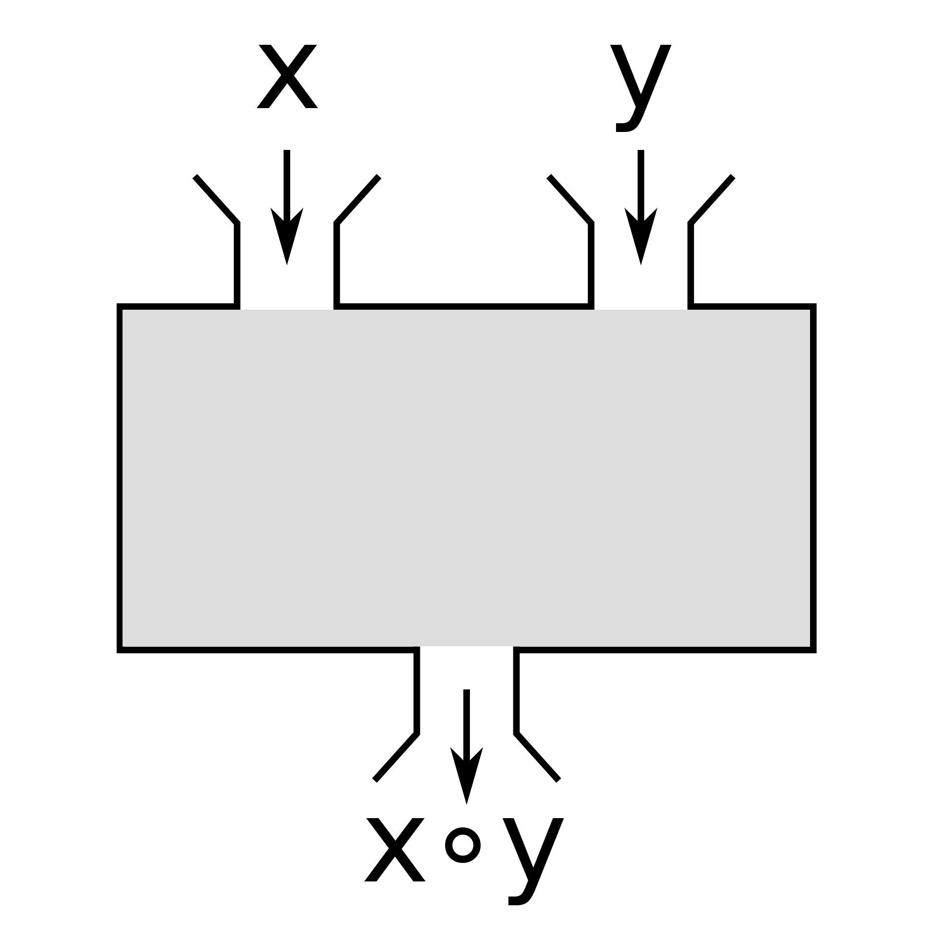
Binary Functions

Slide 105
Working with Functions

Slide 106
Single parameter function
> let square x = x * x
val square: x: int -> int
Components of a function declaration include: let / name, parameters, body

Slide 107
Functions are expressions, and expressions return a value, even if the value is ()

Slide 108
Return value
> let square x = x * x
val square: x: int -> int
Functions are expressions, and expressions return a value, even if the value is ()

Slide 109
Multiline functions
let square x =
x * x
val square: x: int -> int
Functions can span multiple lines. Indent the lines of the function. When done, go back to outer indent (or ;; in fsi).

Slide 110
Function Signature
> let square x = x * x
val square: x: int -> int
Type after the last arrow is the return type
All other types are function parameters
All types are inferred, including the return type

Slide 111
Call a function
> let square x = x * x
val square: x: int -> int
> square 3
val it: int = 9
Function name followed by the parameters separated by spaces

Slide 112
This is an error
> let square x = x * x
val square: x: int -> int
> square 3.
error FS0001: This expression was expected to have type
'int'
but here has type
'float'
Function name followed by the parameters separated by spaces

Slide 113
Coerce type of parameter
> let square (x: float) = x * x
val square: x: float -> float
> square 3.
val it: float = 9.0
square 3
val it: float = 9.0
Specify the name, the a : and type, and surround those three with parentheses.

Slide 114
Casting
> float;;
val it: (int -> float) = <fun:it@59-7>
let square x =
float (x * x)
val square: x: int -> float
> square 3
val it: float = 9.0
square 3.
// error message omitted
Casting is performed using functions, following with the functional nature of F#.

Slide 115
Specify return type
> float;;
val it: (int -> float) = <fun:it@59-7>
let square x : float =
float (x * x)
val square: x: int -> float
: <type name> at end of declaration

Slide 116
Specify type of parameter
let square (x : float) =
x * x
val square: x: float -> float
Each parameter is wrapped in parentheses with a : and type name

Slide 117
Function overloading is not possible in F#

Slide 118
square 3 + 1

Slide 119
(square 3) + 1 = 10?

Slide 120
(square 3) + 1 = 10?
square (3 + 1) = 16?

Slide 121
square 3 + 1 = 10
val square: x: int -> int

Slide 122
square 3 + 1 = 10
val square: x: int -> int

Slide 123
square 3 + 1 = 10
9

Slide 124
square 3 + 1 = 10
9
+ 1 = 10
val it: (int -> int -> int) = <fun:it@16-4>

Slide 125
square 3 + 1 = 10
9
+ 1 = 10
10
= 10

Slide 126
square 3 + 1 = 10
9
+ 1 = 10
10
= 10
val it: ('a -> 'a -> bool) when 'a: equality

Slide 127
square 3 + 1 = 10
9
+ 1 = 10
10
= 10
val it: bool = true

Slide 128
Multiple parameter functions
> let distance x y =
let delta = x - y
if delta < 0 then -delta else delta
val distance: x: int -> y: int -> int
> distance 1 2
val it: int = 1
> distance 2 1
val it: int = 1
Function name followed by the parameter names separated by spaces.

Slide 129
Parameter
The definition of a value expected by a function
Citation: Author/Source, Title, Link/Short URL

Slide 130
Argument
The value provided for a parameter when calling a function
Citation: Author/Source, Title, Link/Short URL

Slide 131
Type inference rule of thumb
If you have a parameter without a type annotation then inference will tend to fail due to framework library overloads. Type specification on the parameter then force correctness
Citation: Author/Source, Title, Link/Short URL

Slide 132
Outer functions (in an API)
Specify types to formalize the API.
Citation: Author/Source, Title, Link/Short URL

Slide 133
Wait, what is that function signature?

Slide 134
Wait, what is that function signature?
val distance: x: int -> y: int -> int

Slide 135
All F# functions internally are single parameter
> let distance x y =
let delta = x - y
if delta < 0 then -delta else delta
val distance: x: int -> y: int -> int
Multiple parameter functions are syntactic sugar

Slide 136
This is immensely important to functional programming for partial application and currying

Slide 137
Partial Application and Currying

